Slide 1




GEMOC modeling crash course
---An introduction to EMF tooling ---
2017
Didier Vojtisek (Inria)
http://people.rennes.inria.fr/Didier.Vojtisek/
Didier.vojtisek@inria.fr
Benoit Combemale (Inria & Univ. Rennes 1)
http://people.irisa.fr/Benoit.Combemale
benoit.combemale@irisa.fr
@bcombemale

Slide 2
Course main purpose
see how EMF+GEMOC technologies helps to (semi-automatically) build the tooling for a DSL IDE
Download the GEMOC studio (dev version)

Slide 3


Course content
Part 1. General introduction
Modeling/Language
DSL
Part 2. Technology introduction
Hands-On teaser :
Finite State Machine example
Eclipse
Ecore
OCL
Xtext
Sirius
K3/Melange
GEMOC model debugger
Hands-on : wrap up
Part 3. Scaling up - Going further
Concurrency
Coordination

Slide 4
You will learn how to
Automatically translate abstract design models to executable code, test cases and documentation
Automatically manipulate your model/code to analyze and refactor it
Build or customize your own abstractions, or even software languages and development environments, to build complex, domain-specific, software-intensive systems
Note: Domain may not be software related !
Eventually limit the accidental complexity of industrial processes developments

Slide 5
Additionally, you will also
Demystify language formalisms, paradigms and principles (Grammar vs 'Meta'-models)
Have a deeper insight on some of them
Manage the industrial complexity of developments and associated toolchains

Slide 6
Part 1
Technology introduction

Slide 7
What is a language?
« A system of signs, symbols, gestures, or rules used in communicating »
« The special vocabulary and usages of a scientific, professional, or other group »
« A system of symbols and rules used for communication with or between computers. »

Slide 8
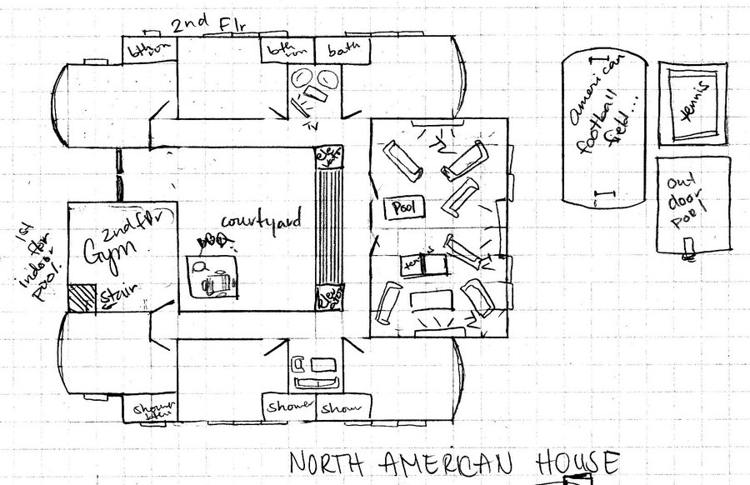
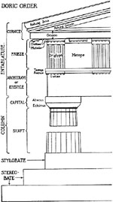
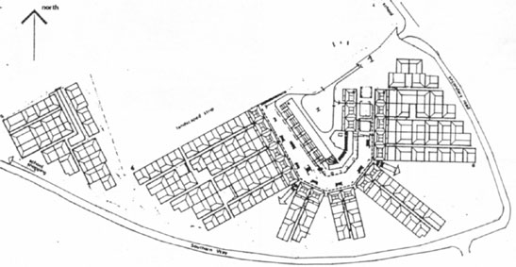
Architecture
Architecture

Slide 9
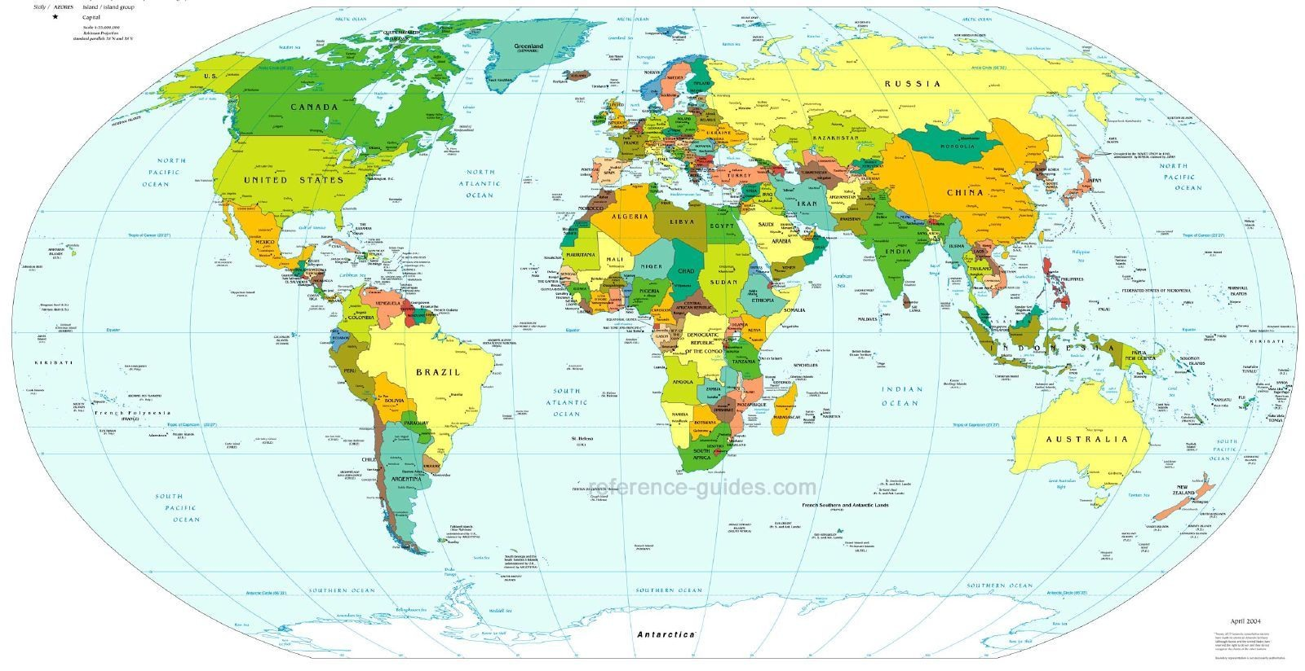
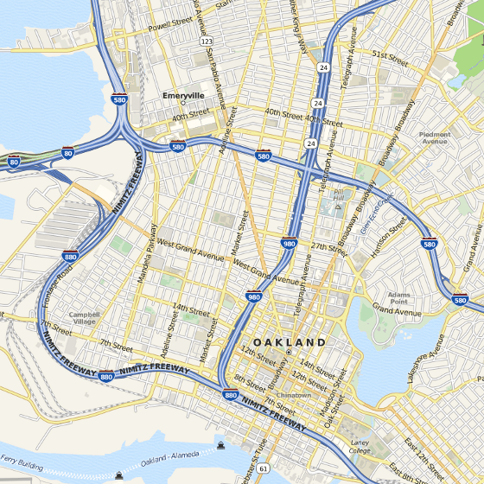
Cartography
Cartography

Slide 10
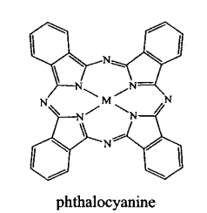
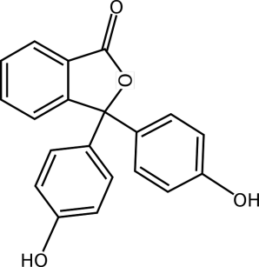
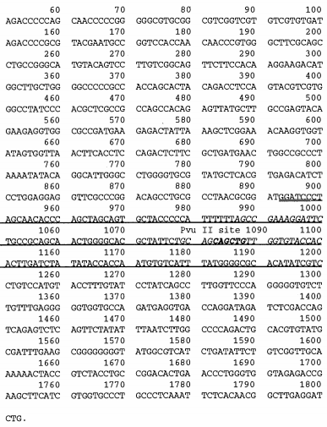
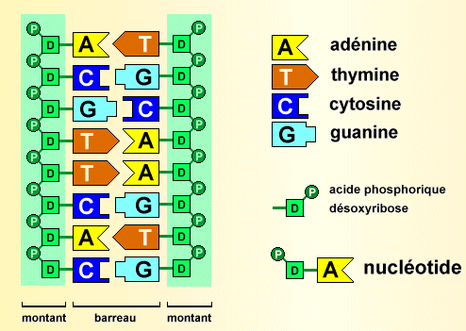
Biology
Biology

Slide 11
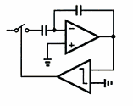
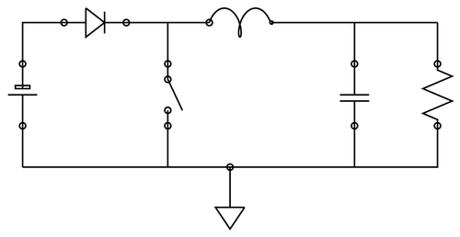
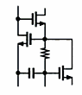
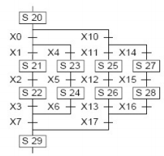
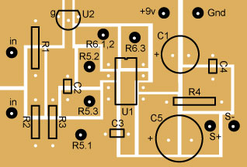
Electronics
Electronics

Slide 12
In Software Engineering
« Languages are the primary way in which system developers communicate, design and implement software systems »

Slide 13
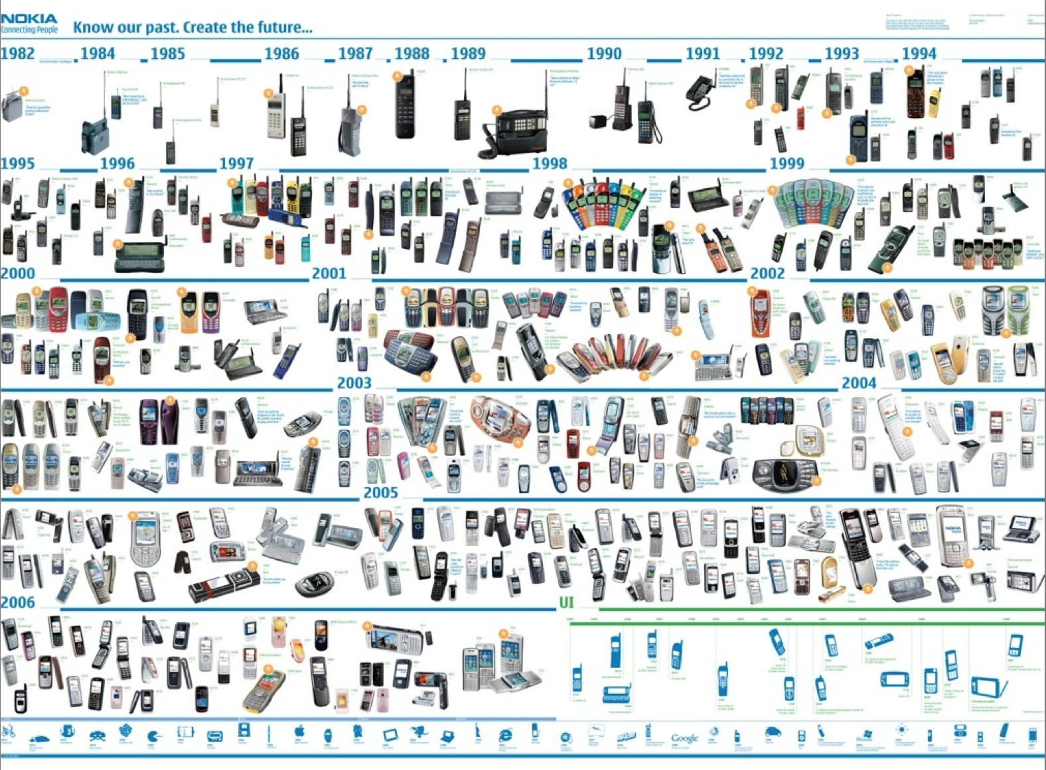





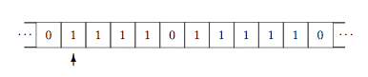
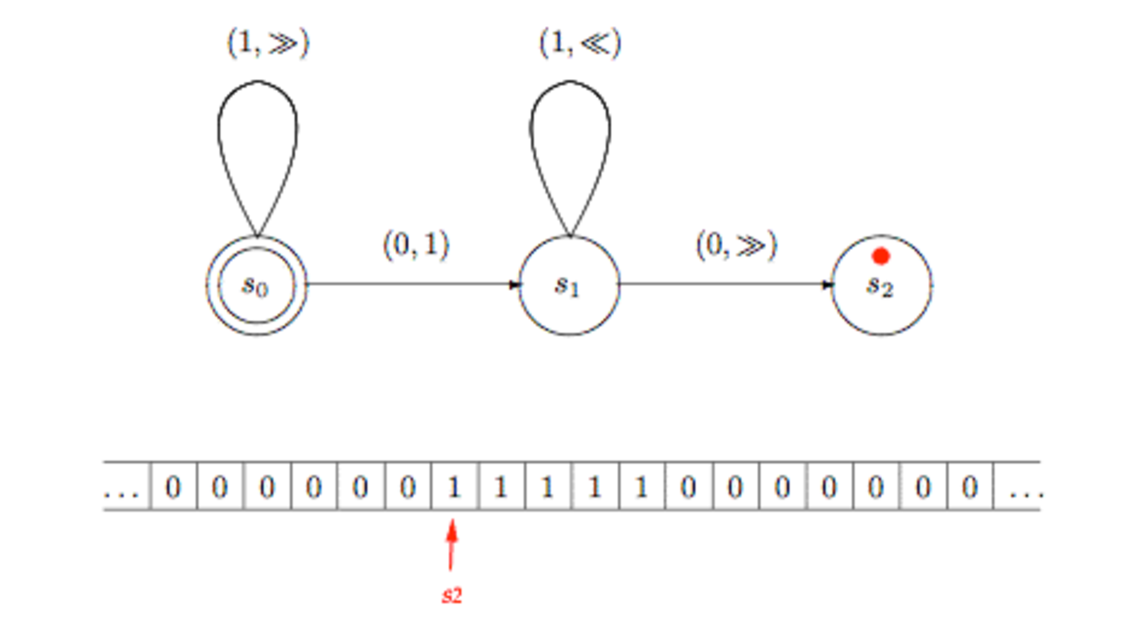
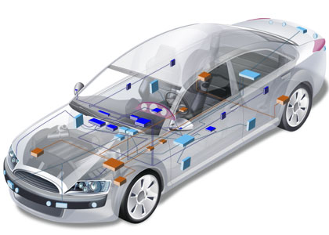

General Purpose
Languages
Assembly ?
COBOL ? LISP ? C ? C++ ?
Java? PHP ? C# ? Ruby ?
Notes:
http://plato.stanford.edu/entries/turing-machine/

Slide 14
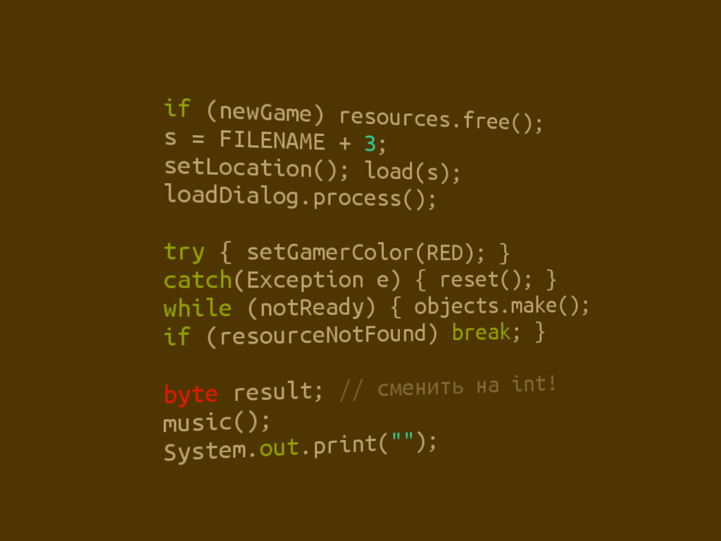

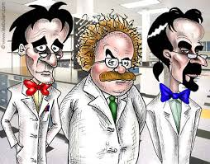

Limits of General Purpose Languages (1)
Abstractions and notations used are not natural/suitable for the stakeholders

Slide 15

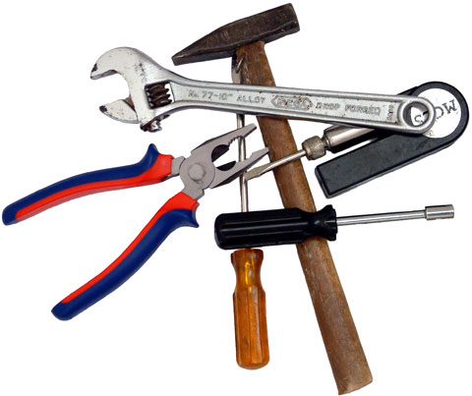
Limits of General Purpose Languages (2)
Not targeted to a particular kind of problem, but to any kinds of software problem.

Slide 16
Domain Specific Languages
Targeted to a particular kind of problem, with dedicated notations (textual or graphical), support (editor, checkers, etc.)
Promises: more « efficient » languages for resolving a set of specific problems in a domain

Slide 17
Domain Specific Languages (DSLs)
Long history: used for almost as long as computing has been done.
You’re using DSLs in a daily basis
You’ve learnt many DSLs in your curriculum
Examples to come!

Slide 18
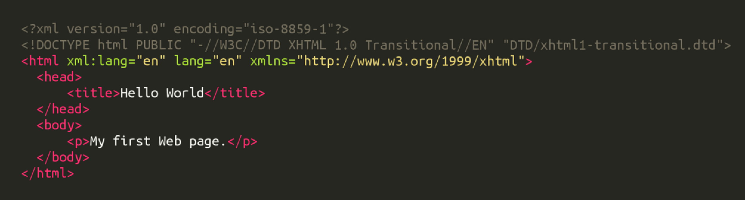
HTML
Domain: web (markup)

Slide 19
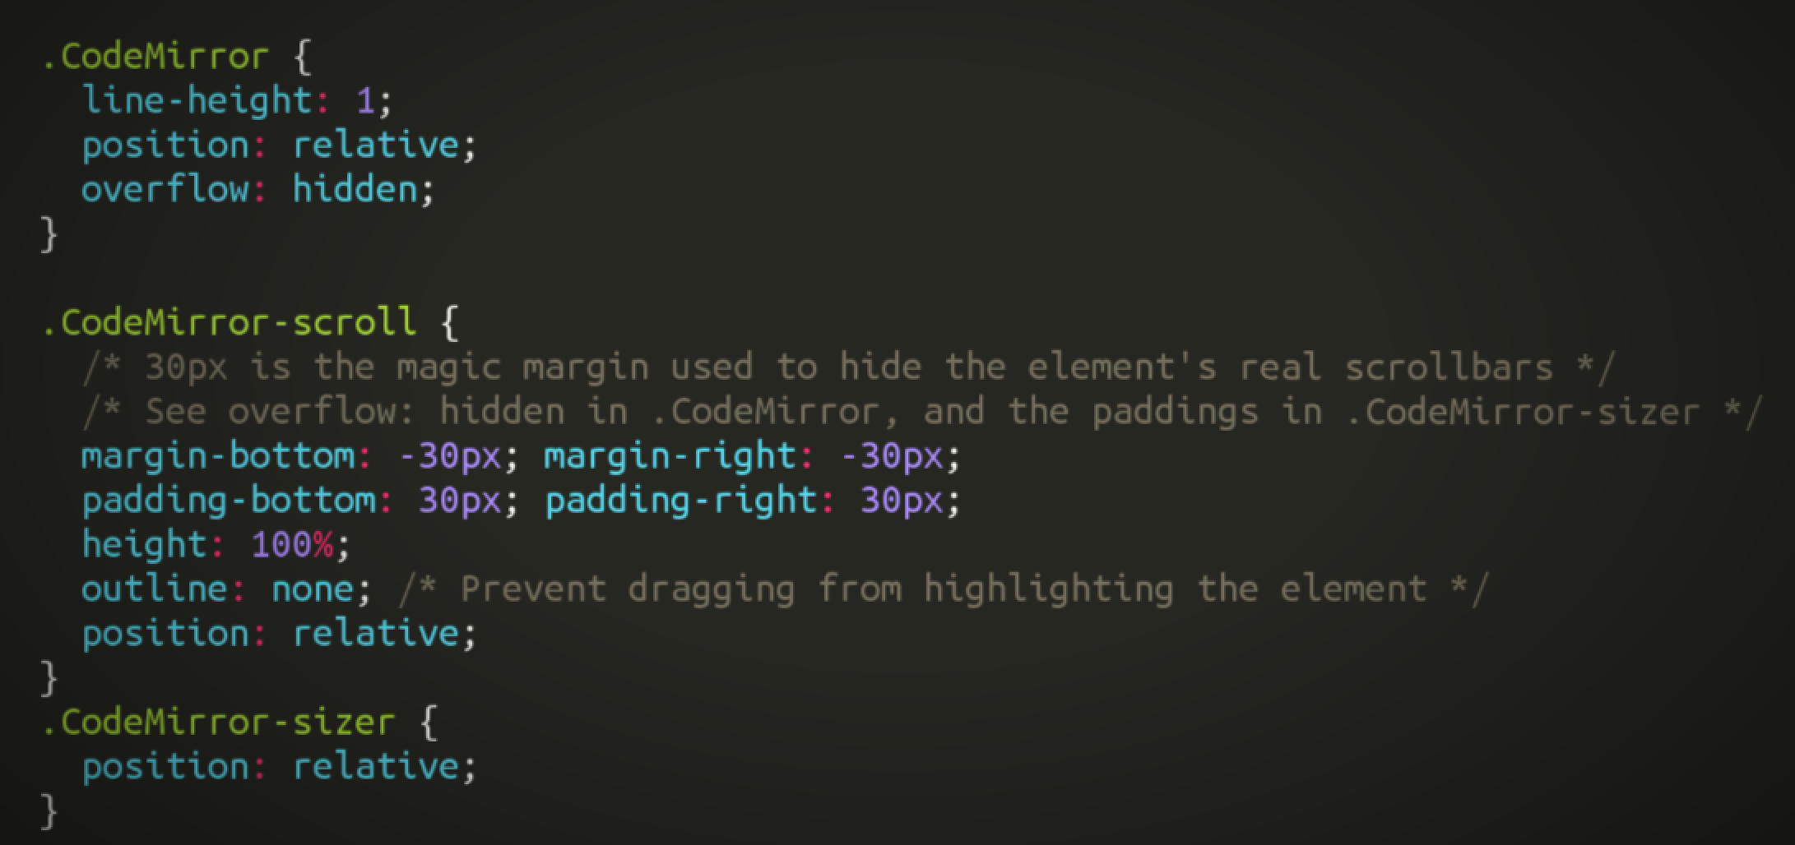
CSS
Domain: web (styling)

Slide 20
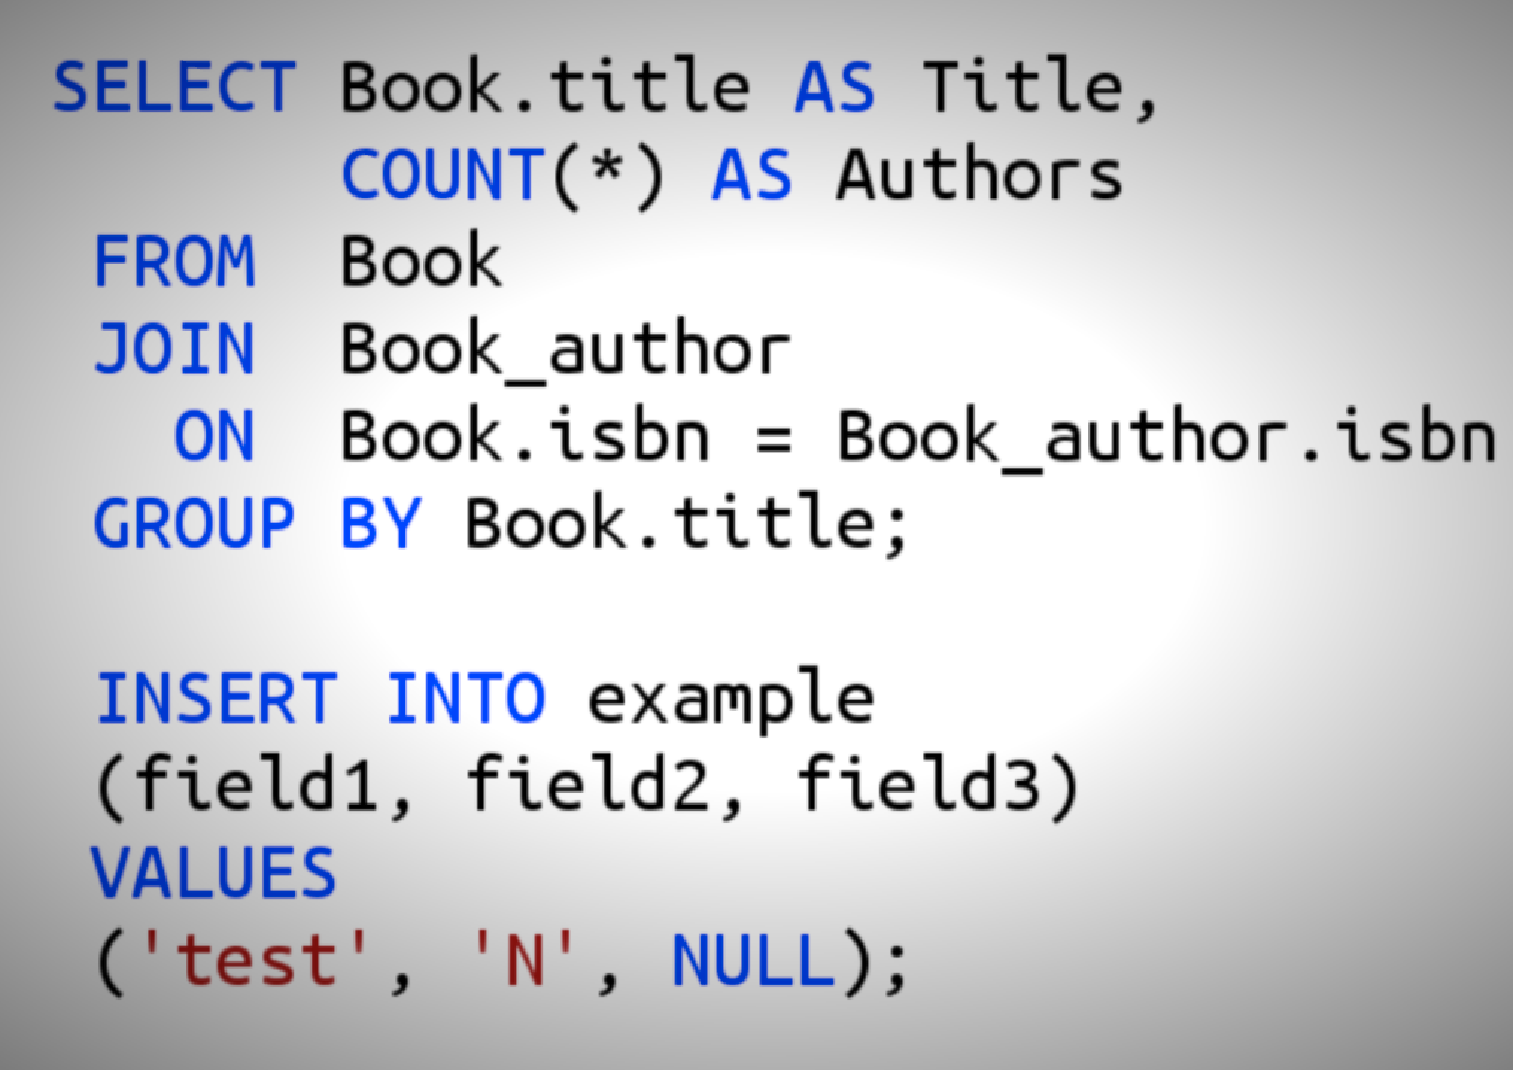
SQL
Domain: database (query)

Slide 21
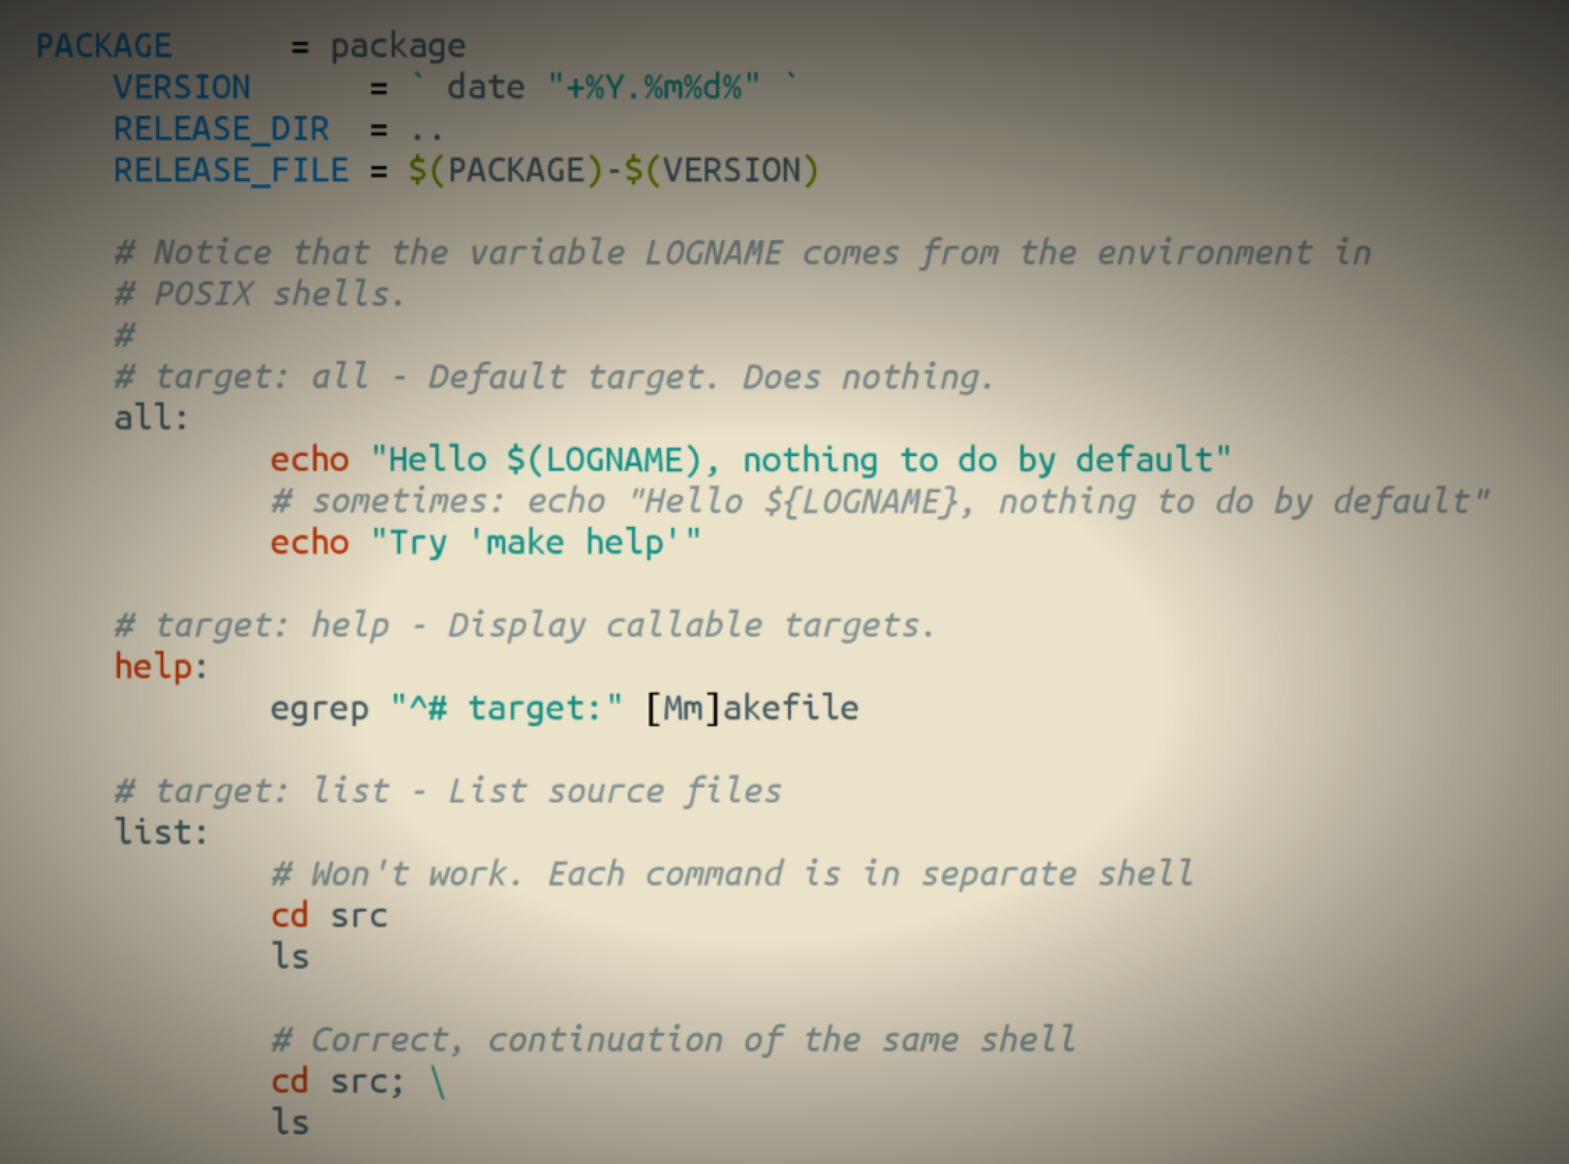
Makefile
Domain: software building

Slide 22
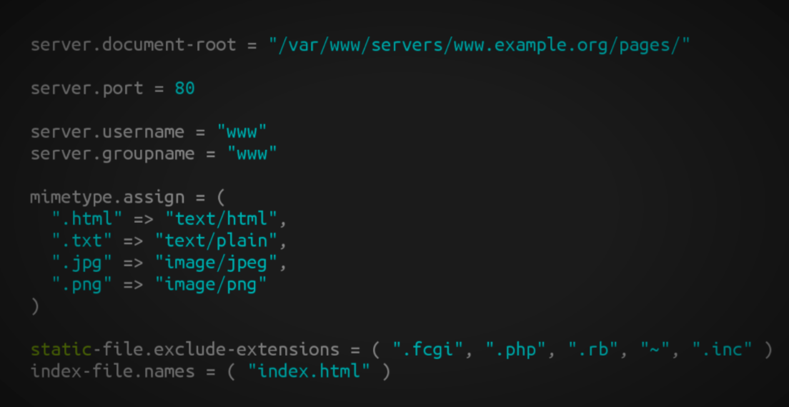
Lighthttpd configuration file
Domain: web server (configuration)

Slide 23
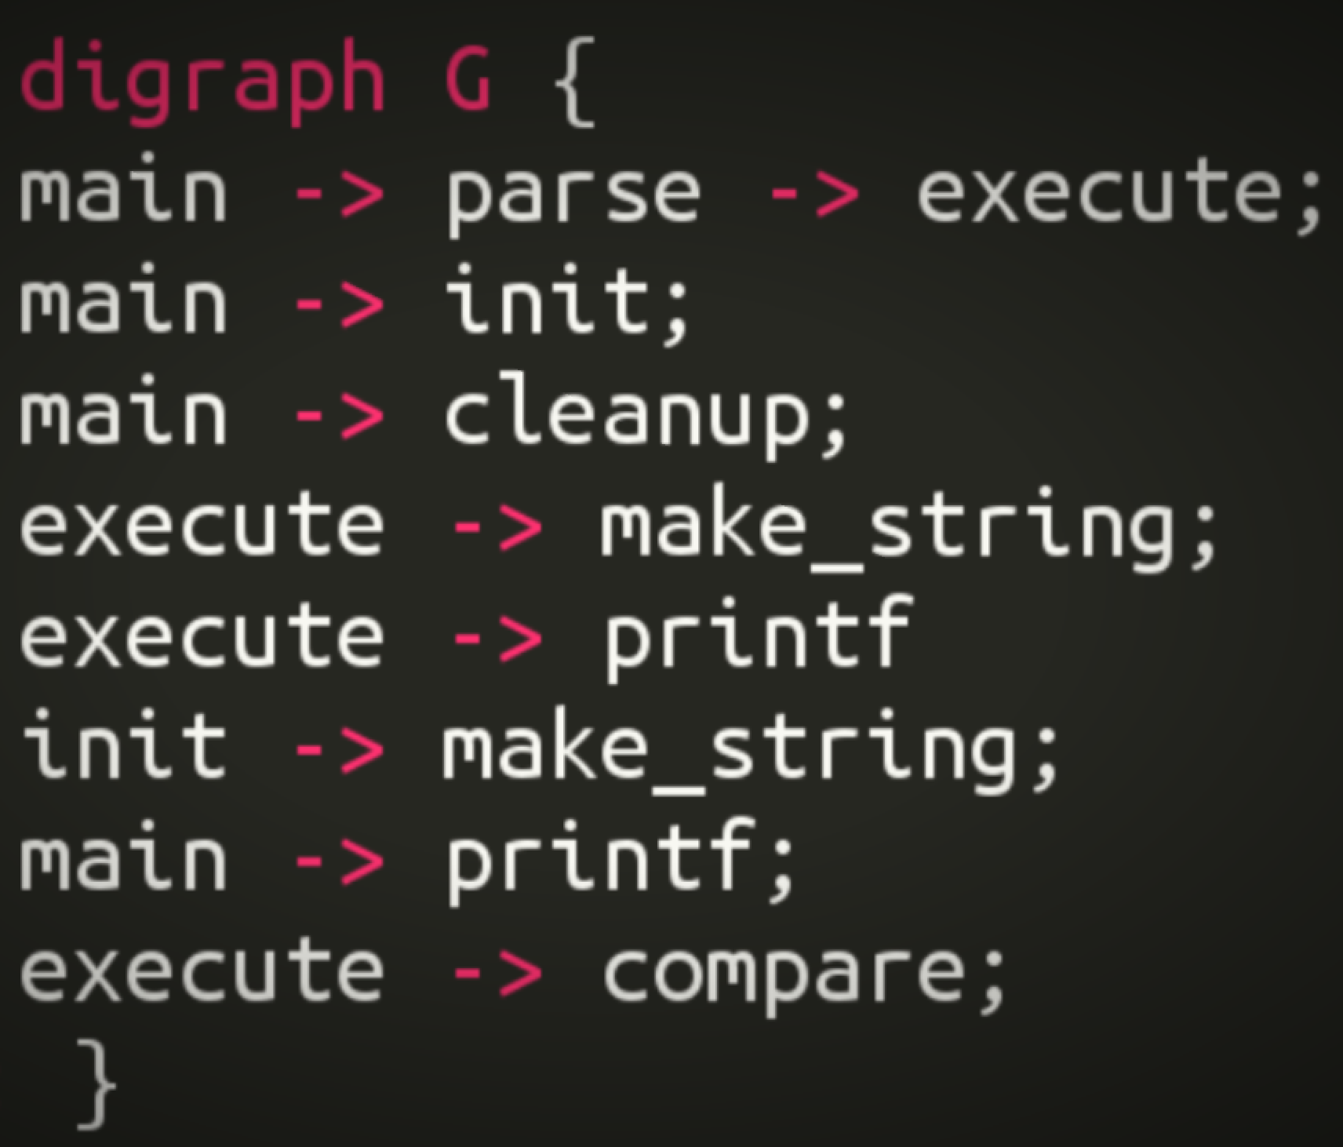
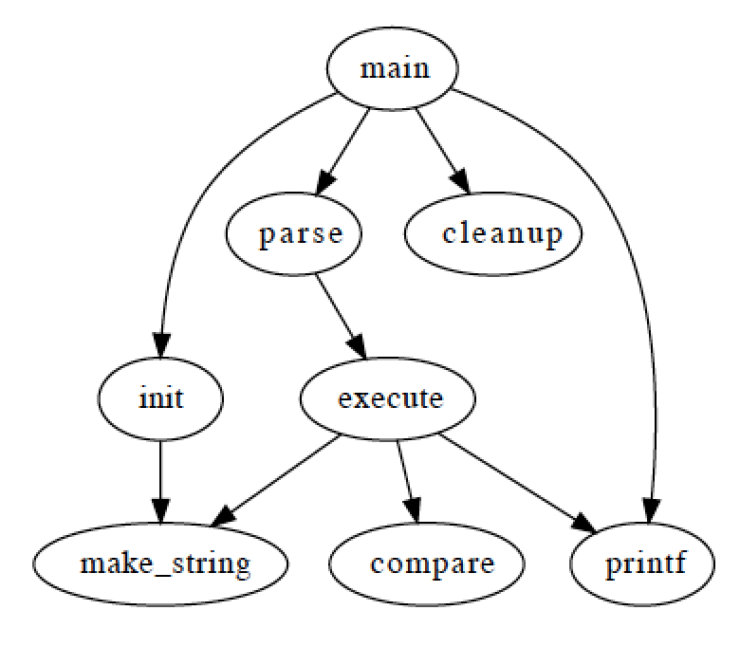
Graphviz
Domain: graph (drawing)

Slide 24
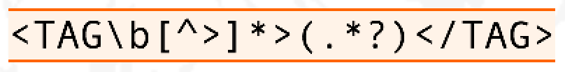
Regular expression
Domain: strings (pattern matching)

Slide 25
OCL
self.questions->size
self.employer->size
self.employee->select (v | v.wages>10000 )->size
Student.allInstances
->forAll( p1, p2 |
p1 <> p2 implies p1.name <> p2.name )
Domain: model management

Slide 26
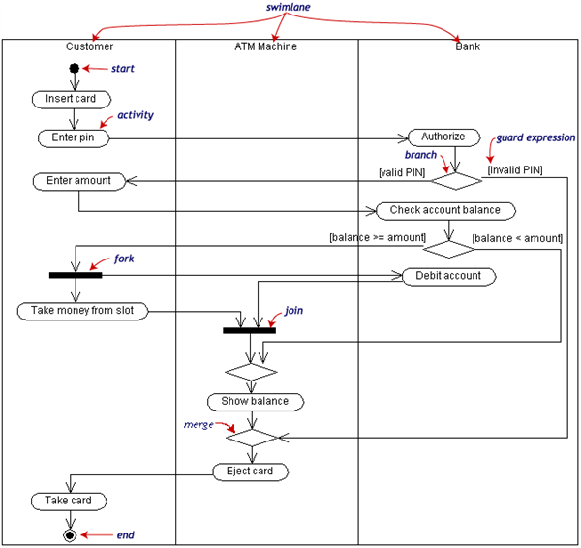
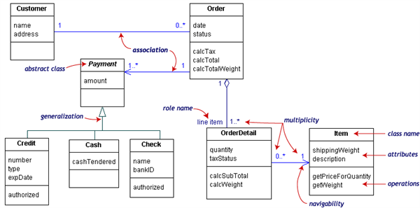
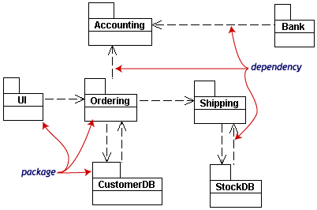
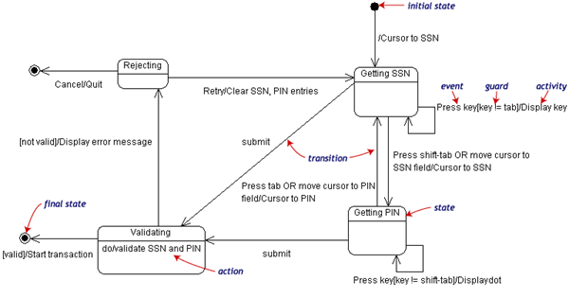
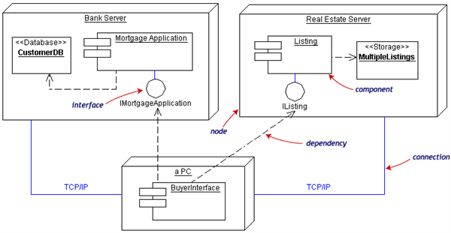
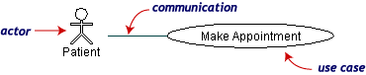
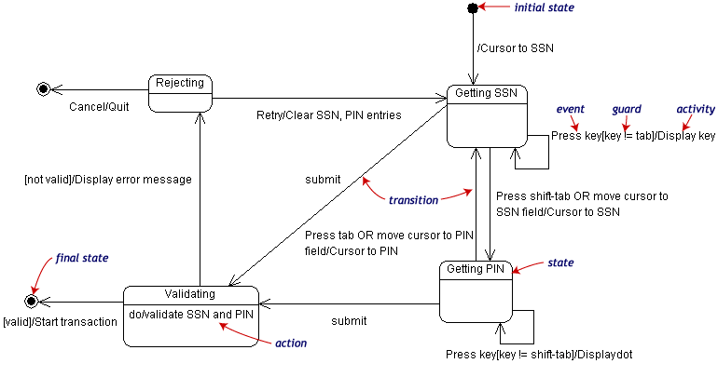
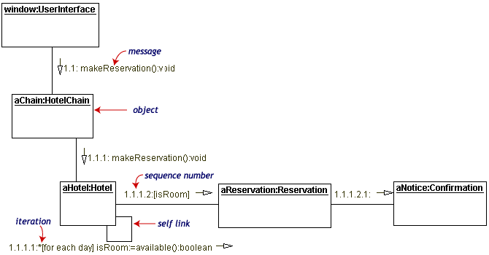
UML can be seen as a collection of domain-specific modeling languages
Structural
Behavioral

Slide 27
Defining languages

Slide 28
Software Language Engineering (SLE)
Application of systematic, disciplined, and measurable approaches to the development, deployment, use, and maintenance of software (domain-specific) languages
Supported by various kind of "language workbench"
Eclipse EMF, xText, Sirius, Melange, GEMOC, Papyrus
Jetbrain’s MPS
MS DSL Tools
Etc.
Various shapes and ways to implement software languages
External, internal or embedded DSLs, Profile, etc.
Grammar, metamodel, ontology, etc.
More and more literature, a dedicated Intl. conference (ACM SLE, cf. http://www.sleconf.org)…

Slide 29
Comparing Abstract Syntax Systems
Technology #1
(formal grammars
attribute grammars,
etc.)
Technology #2
(MOF + OCL)
Technology #3
(XML Meta-Language)
Technology #4
(Ontology engineering)
M³
A XML DTD
Or Schema
EBNF
MOF
Upper Level
Ontologies
M²
Pascal Language
Grammar
The UML
meta-Model
A XML
document
A XML DTD
or Schema
KIF
Theories
M¹
+Description
Logics
+Conceptual
Graphs
+etc.
A specific
Pascal Program
A Specific
UML Model
A XML
document
+ Xlink, Xpath, XSLT
+ RDF, OIL, DAML
+ etc.
A specific
execution
of a Pascal
program
A Specific
phenomenon
corresponding to
a UML Model
[XMI=MOF+XML+OCL]
(From J. Bézivin)

Slide 30
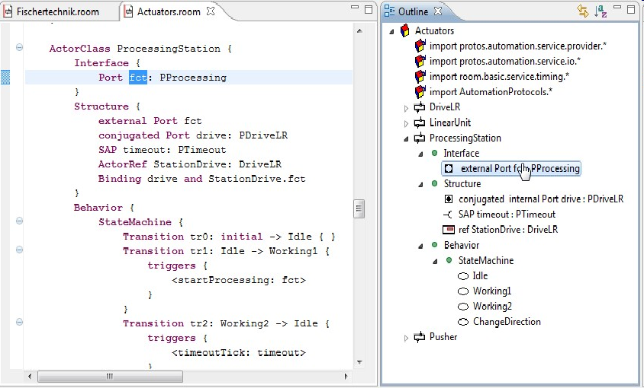
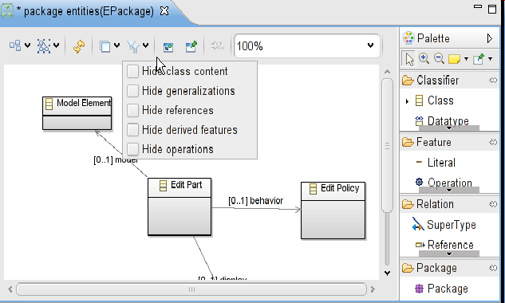
Bridging grammar/model space

Slide 31
Domain-Specific Languages (DSLs)
Targeted to a particular kind of problem, with dedicated notations (textual or graphical), support (editor, checkers, etc.)
Promises: more « efficient » languages for resolving a set of specific problems in a domain

Slide 32
Model-Driven Engineering (MDE)
Engineering Modeling Languages: Turning Domain Knowledge into Tools, by Benoit Combemale, Robert B. France, Jean-Marc Jézéquel, Bernhard Rumpe, Jim R.H. Steel, and Didier Vojtisek. Chapman and Hall/CRC, pp.398, 2016. Companion website: http://mdebook.irisa.fr

Slide 33
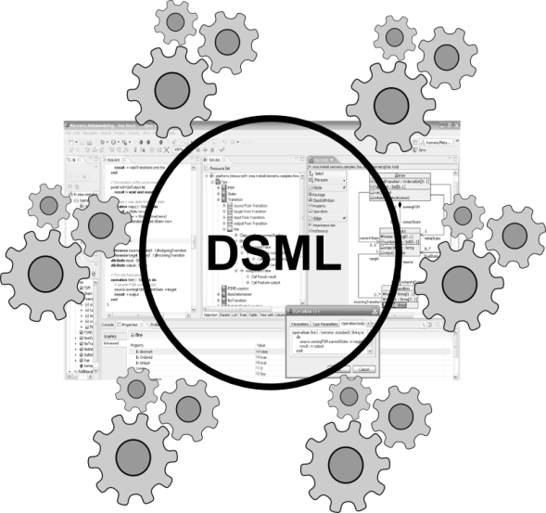
Model-Driven Engineering (MDE)
Editors
(textuals, graphicals, …)
Checkers
(static & dynamics)
Compilers
Test generators
Translators
Simulators
Code generators
Analyzers
Refactoring
Etc.
Engineering Modeling Languages: Turning Domain Knowledge into Tools, by Benoit Combemale, Robert B. France, Jean-Marc Jézéquel, Bernhard Rumpe, Jim R.H. Steel, and Didier Vojtisek. Chapman and Hall/CRC, pp.398, 2016. Companion website: http://mdebook.irisa.fr

Slide 34
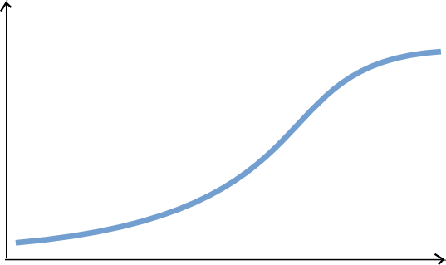
Complete environment
Large scale deploiement and distribution
Rich modeling tooling
(graphical, textuals, forms)
Live Collaboration « à la google doc »
Customisations
Large models
Parametric code generators
Documentation genetators
Analysis tools
Mission critical : tested and valided !
You are here
Lot of work
Some hours
Features

Slide 35
Easy automation
Basic editing features
Reflective and dynamic editors
Déploiement à travers le repo source (GIT..)
Collaboration classique
EMF compare
Code generation!
Lot of work
You are her
Some hours
Features

Slide 36
Part 2
Technology introduction + Hands-on

Slide 37
Eclipse plugin structure and lifecycle
integrated development environment with base workspace and an extensible plug-in system
Contribute to existing IDE
Open structure with thirdparty contributions
Update site, market place, …
Or create your own application
Rich Client Platform (RCP) for developing general purpose applications
-> component based / service base approach
Equinox : an implementation of OSGI core framework
Helps to define service contracts
Ie. Pick in the huge community plugins to build your application

Slide 38
Eclipse
Do not be afraid of the number of "project" in your workspace
Most of them are due to the split of the java packages for easier deployment and dependency management.
Ex: be able to pick only required feature when building a product
Possiblity to embed and call native code (model checker for ex.)

Slide 39
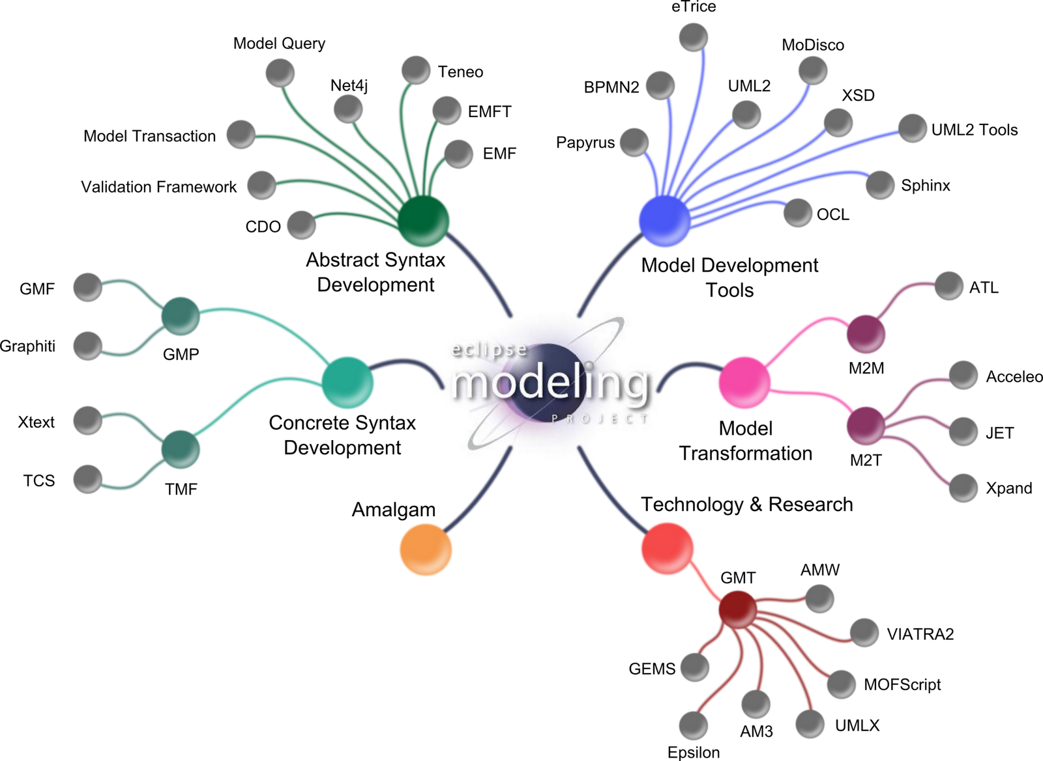
Eclipse Modeling Project
GEMOC

Slide 40
Define the domain
Editors
(textuals, graphicals, …)
Checkers
(static & dynamics)
Documentation generators
Compilers
Test generators
Translators
Simulators
Code generators
Analyzers
Refactoring
Etc.

Slide 41
Ecore/EMF
EMF serves as the foundation: It provides the Ecore meta-metamodel (basically a Class diagram ), and frameworks and tools around it :
EMF provides almost for free (among other features)
serialization (XMI)
Tree editor
either reflective, or generated with possibility to customize
Edition support (outline, notification API for other editors, …)
Java manipulation API
EMF compatible projects use this as a base to propose extended services

Slide 42




Metamodeling approach
Language Engineers
Language Users
Viewpoint
(graphical editor)
Grammar
(textual editor)
Behavioral
semantics
(animator)
Domain
Globalization,
execution,
simulation and
animation
Data
Views and
static checking
Textual editing and
static checking

Slide 43
Metamodeling approach
Language Engineers
Language Users
Domain
Data

Slide 44
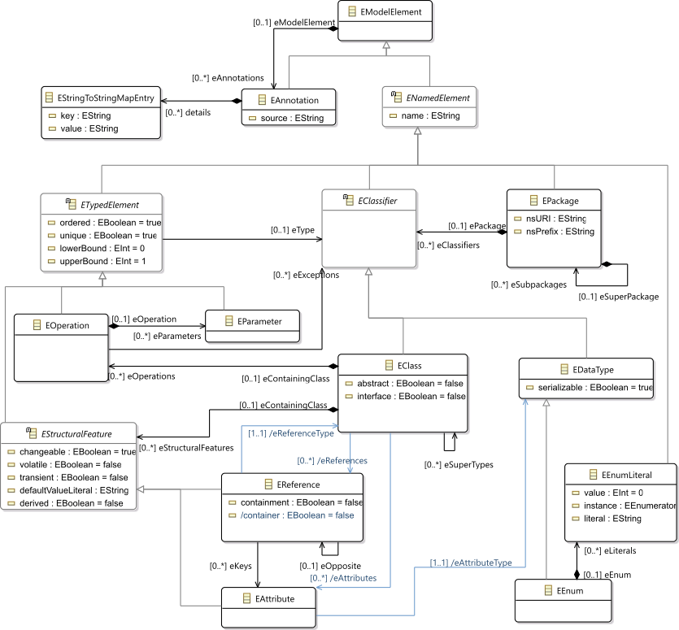
Ecore most used concepts
(ie. Removed most helper derived features, operations and generic support)

Slide 45
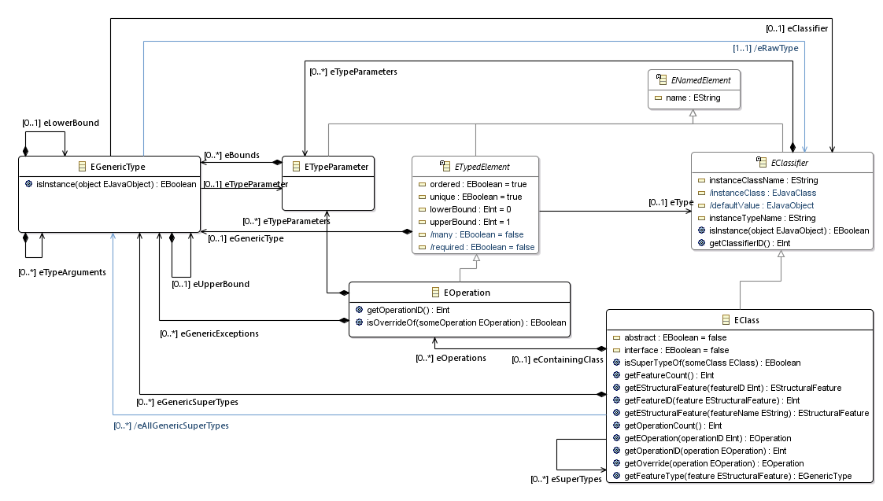
Ecore extended usage
Support of generics
TODO Add usage picture in the tree editor

Slide 46
Design your domain
Using the Ecore tree editor (EMF)
Using the graphical editor (Ecore tools)
Using a textual editor (oclinecore, …)

Slide 47
Define the semantic domain of FSM

Slide 48
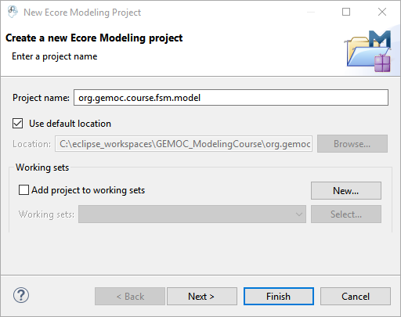
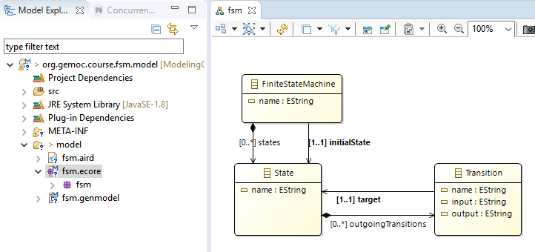
Create the following "ecore modeling project" with these concepts

Slide 49
Containment
A metamodel is not only a graph
Containment information is used by many tools to provide "smart" default implementations
Tree editor, textual syntaxes, graphical syntaxes, …
Impact on model manipulation/transformation

Slide 50
Graph with constraints : assignment example
Composition
Association
A
b
B
C
c
d
D
0..1
1
*
container()
c
a1:A
b
b1:B
c1:C
d
d1:D
a2:A
d2:D
a2.b := b1
d2.c := c1
a1:A
b
b1:B
c1:C
d
d1:D
c
a2:A
container()
d
d2:D

Slide 51
Tree editor
Editors
(textuals, graphicals, …)
Checkers
(static & dynamics)
Documentation generators
Compilers
Test generators
Translators
Simulators
Code generators
Analyzers
Refactoring
Etc.

Slide 52
Basic tree editor
For free with EMF
Structure also used as outline for other editors
Customizable via
genmodel
replacement of default icons
Modification of the generated code
For example for custom labels or conditionnal icons
Do not forget to add "generated NOT" in the method comment

Slide 53
Create a model conforming to to the metamodel

Slide 54
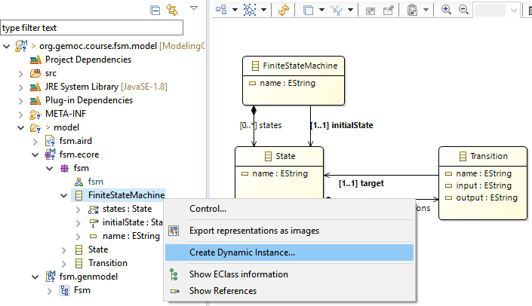
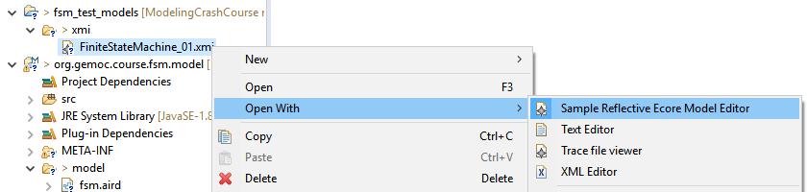
Create a sample model in current workbench
Creates an XMI either in a test folder of your project or in a separate project
Open with the Reflective editor

Slide 55
OCL invariant
Editors
(textuals, graphicals, …)
Checkers
(static & dynamics)
Documentation generators
Compilers
Test generators
Translators
Simulators
Code generators
Analyzers
Refactoring
Etc.

Slide 56
OCL
Class diagram structure implies design choices
Inviariant (written in OCL for ex) can complement it in order to enforce the consistency of models

Slide 57
Add some OCL invariant

Slide 58
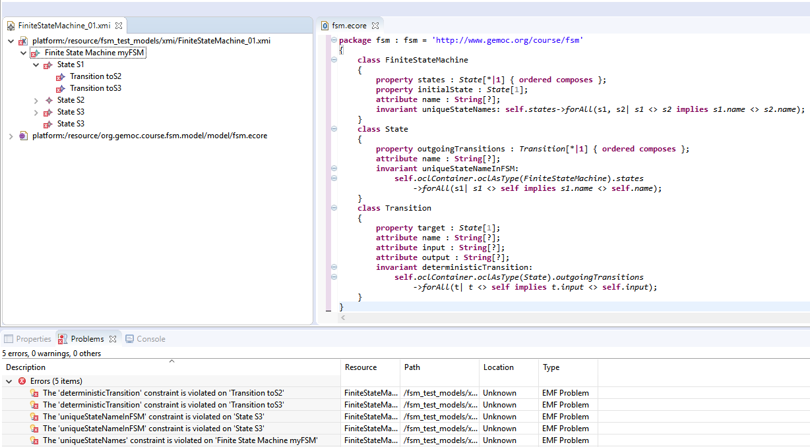
Open fsm.ecore in text editor and add some constraint
OCLInEcore
For example: check name uniqueness
context FiniteStateMachine
invariant uniqueStateNames:
self.states->forAll(s1, s2| s1 <> s2 implies s1.name <> s2.name);

Slide 59
Textual syntax
Editors
(textuals, graphicals, …)
Checkers
(static & dynamics)
Documentation generators
Compilers
Test generators
Translators
Simulators
Code generators
Analyzers
Refactoring
Etc.

Slide 60
Metamodeling approach
Language Engineers
Language Users
Grammar
(textual editor)
Domain
Data
Textual editing and
static checking

Slide 61
M³
EBNF
Metametamodel
Grammar
Metamodel
M²
M¹
Source
Code
Model

Slide 62

Give me a grammar,
I’ll give you (for free)
* a comprehensive editor (auto-completion, syntax highlitening, etc.) in Eclipse
* an Ecore metamodel and facilities to load/serialize/visit conformant models (Java ecosystem)
* extension to override/extend « default » facilities (e.g., checker)

Slide 63
Bridging grammar/model space

Slide 64

Xtext, Grammar, Metamodel
Xtext, Grammar, Metamodel
Grammar
Metamodel
conforms To
conforms To
Source Code
A
Model A

Slide 65
TODO add grammar mapping

Slide 66
Get default xText editor
then improve its grammar

Slide 67
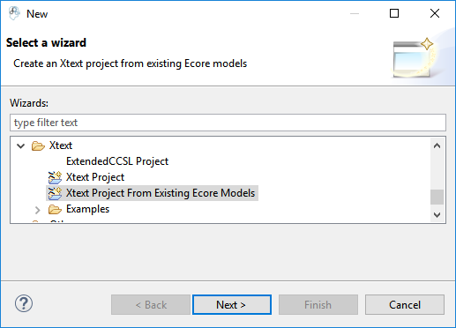


Generate text editor

Slide 68


Adapt grammar
Add EcoreAutoRegister to help removing errors

Slide 69

Test in a runtime workbench

Slide 70

Try the text editor

Slide 71

Improve text editor outline
Genmodel : generate edit
Change icons
Adapt labels

Slide 72
Graphical syntax
Editors
(textuals, graphicals, …)
Checkers
(static & dynamics)
Documentation generators
Compilers
Test generators
Translators
Simulators
Code generators
Analyzers
Refactoring
Etc.

Slide 73
Metamodeling approach
Language Engineers
Language Users
Grammar
(textual editor)
Viewpoint
(graphical editor)
Domain
Data
Textual editing and
static checking
Views and
static checking

Slide 74
Bridging grammar/model space

Slide 75




Sirius : Principles
Language desugner/developers
Final User
Specification environment
Runtime environment

Slide 76

Sirius: Examples of Viewpoints
….

Slide 77
Create Sirius viewpoint
then test view on models

Slide 78


Slide 79




Create viewpoint

Slide 80


Xtext + Sirius
Model can be edited on both editors

Slide 81
Use data in models
Editors
(textuals, graphicals, …)
Checkers
(static & dynamics)
Documentation generators
Compilers
Test generators
Translators
Simulators
Code generators
Analyzers
Refactoring
Etc.

Slide 82
xText generator

Slide 83
Generate a HTML file sumarizing the model contenet

Slide 84

Simple code/document generator in xText

Slide 85


Slide 86
Add behaviour to models
Editors
(textuals, graphicals, …)
Checkers
(static & dynamics)
Documentation generators
Compilers
Test generators
Translators
Simulators
Code generators
Analyzers
Refactoring
Etc.

Slide 87
Metamodeling approach
Language Engineers
Language Users
Grammar
(textual editor)
Viewpoint
(graphical editor)
Behavioral
semantics
(animator)
Domain
Views and
static checking
Globalization,
execution,
simulation and
animation
Textual editing and
static checking
Data

Slide 88
Add behavior / write transformation
This is usually a traversal task that navigating the model according to the metamodel concepts in order to perform some actions in one or more pass
Adding operations (with "generated NOT") in the ecore gives a nice structuration based on the metamodel concepts
BUT this breaks the separation of concern requirement
Traditional approaches : visitor design pattern
EMF proposes in the model java implementation a pre built variant of the visitor pattern : switch
However, it doesn't scale up very well in case of multiple metamodels; and is

Slide 89
Kermeta
Can be considered as an advanced visitor pattern but with an aspect oriented syntactic sugar
Ie. The programmers see the classes as if they where "reopened" and extended
Extension supports new operations but also new attributes, new association or new inheritance

Slide 90
Melange
2 roles:
Language definition,
Compose languages part in order to build language implementation

Slide 91


Melange simpliest example
Define a language based on an ecore
Everything is in a single ecore
The model type (MT) is equal to the ecore

Slide 92


Melange – Combining language parts
Adds operation and attributes
may add new concepts too by using multiple ecore files (possibly with operator such as slice)
Melange generates the new resulting implementation
We may consider only the result to build additional tooling and ignore the initial parts (which have been copied in the new runtime)

Slide 93


Melange – language relation
Inheritance (implicit or explicit)
Support for convertion services (adapter)
An XSFSM model can be processed by transformation written for FSM
A FSM model can be loaded as XSFSM
Adapter mechanism provides an equivalent to a "downtype copy" but working on the actual FSM model
Must take care to default values
Editor may be written on FSM and animator on XSFSM

Slide 94
Create a simulator for FSM
Run and debug a model

Slide 95



Behavior with Melange and K3

Slide 96



Slide 97




Slide 98



Slide 99

Implement the behavior
New attributes or refrences

Slide 100

New operations

Slide 101


Traverse the model
Observable operations (Step)

Slide 102


Generate the language extended implementation and adapters
Generate the trace support (require for forward/backward debugging)

Slide 103


Debug models

Slide 104

Debug model

Slide 105
Animating models
Editors
(textuals, graphicals, …)
Checkers
(static & dynamics)
Animators
Documentation generators
Compilers
Test generators
Translators
Simulators
Code generators
Analyzers
Refactoring
Etc.

Slide 106
GEMOC graphical animator
Animation is based on the executable version of the language
Sirius allows to defined viewpoint layers
Let's create a layer using runtime data

Slide 107
Create an animation layer on top of
Run and debug a model

Slide 108




Slide 109


d

Slide 110




